Slide 1
Data acquisition
01/30/2019

Slide 2
Coverage
Acquisition methods
File formats
Static acquisition
Disk structures
Linux acquisition

Slide 3
Data Acquisition Methods
Disk-to-image File (physical acquisition)
Disk-to-Disk Copy
Logical Disk-to-Disk or Disk-to-Data File
Bit-for-bit replications of the original including meta data + deleted files
Compatible with multiple tools
Used with older drives
Hardware or software errors with disk-to-image option
Captures specific files of interest or specific types of files
Used when examining the entire drive is unnecessary

Slide 4
File formats
The most accepted format is the raw file format – originally used by dd.
Includes all data on the artifact as well as everything in between
Some tools will create a raw image and save the additional descriptive data to a separate file
Court systems will likely question your procedures if the entire drive isn’t captured, unless there is a special situation such as a solid-state drive (SSD)

Slide 5
Image File Storage Formats
RAW
Simple sequential flat files or bit-by-bit
PROPRIETARY
Expert Witness - the Unofficial standard
ADVANCED FORENSIC FORMAT
Open source

Slide 6
RAW FORMAT
Advantages:
Disadvantages:
Need same storage space as original disk
Missed data on bad sectors of source drive
Fast Data Transfers
Can Ignore minor data read errors

Slide 7
Proprietary Format
Disadvantages:
Advantages:
Save space on target drive
Splits Image into smaller files for archiving on CD/DVD
Can add Metadata into Image file
Unable to Share Image between different Vendors’ Tools
File Size Limitation of 650 MB to 2 GB

Slide 8
Advanced Forensic Format
AFF
Compresses
Files
No Size Restriction
Provides Metadata
Simple Design with Extensibility
Open Source
Self-Authentication

Slide 9
Static acquisition
Think of a situation where you get to a computer and want to acquire data, what process would you go through –assume the computer is off?

Slide 10
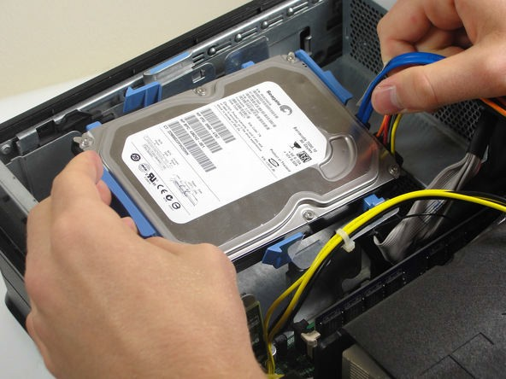
What if you can’t bring the entire computer?
Bring the hard disks
Need to open the computer’s case and extract the hard disk
Then seize the hard disk
If you can’t bring the disk
Boot a trusted forensic OS (e.g., Kali) from DVD / USB drive
May need to access the BIOS first to update the boot sequence
Identify the device (under /dev) that corresponds to the source disk
Perform a logical or bit-stream copy of the disk
Note: use only the forensic tools of the trusted forensic OS!

Slide 11
Disk structures
What do you remember about disk geometry from SY110?

Slide 12
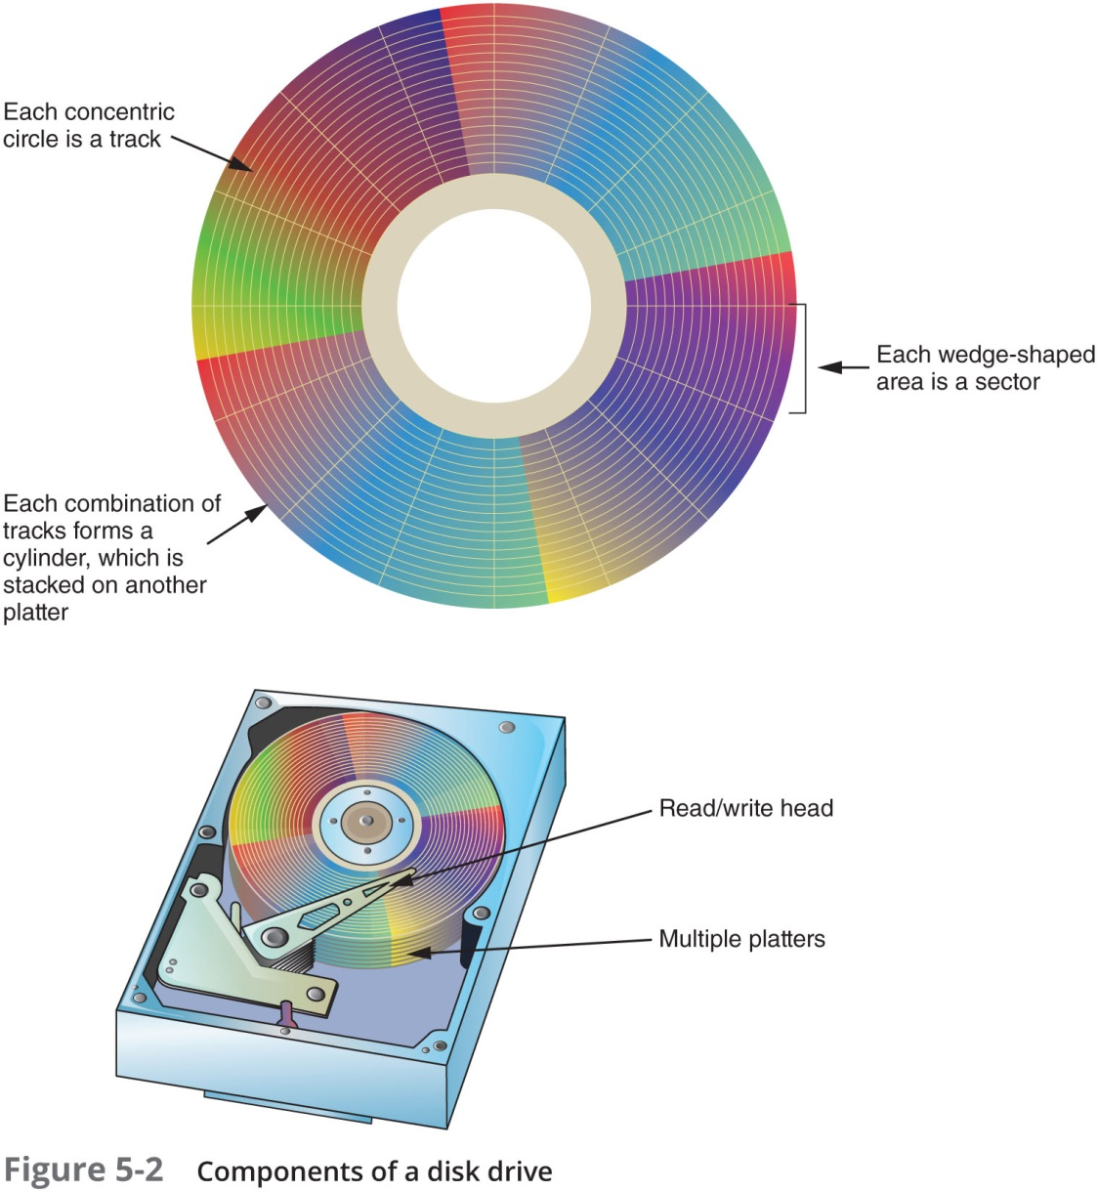
Disk Drives

Slide 13
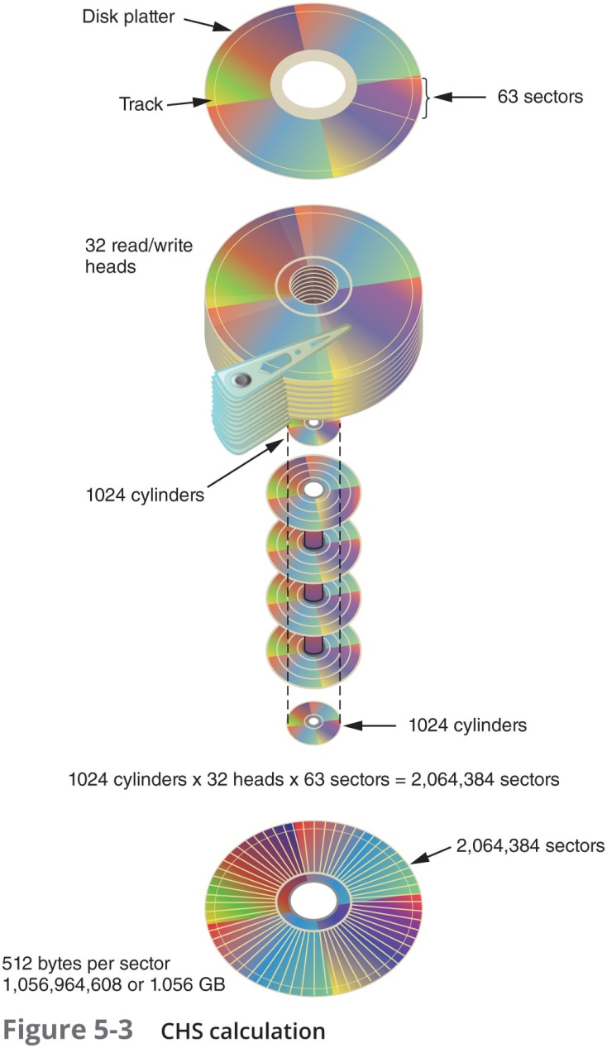
Disk Drives

Slide 14
Microsoft File Structures
In Microsoft file structures, sectors are grouped to form clusters
Storage allocation units of one or more sectors
Clusters range from 512 bytes up to 32,000 bytes each
Combining sectors minimizes the overhead of writing or reading files to a disk

Slide 15
Disk acquisition
What contingency measures do you need to put in place when acquiring a hard disk?

Slide 16
Contingency Planning -Image Acquisitions
Create a duplicate copy of your evidence image file
Make at least two images of digital evidence
Use different tools or techniques
Copy host protected area of a disk drive as well
Consider using a hardware acquisition tool that can access the drive at the BIOS level
Be prepared to deal with encrypted drives
Whole disk encryption feature in Windows called BitLocker makes static acquisitions more difficult
May require user to provide decryption key

Slide 17
Areas of concern on the disk
Host Protected Area
Manufacturer hidden area of a disk.
Store information in such a way that it cannot be easily modified, changed, or accessed by the user, BIOS, or the OS.
HDD utilities, to diagnostic tools, as well as boot sector code.
Device Configuration Overlay(DCO)
Imaging and tool availability

Slide 18
Starting an acquisition
Clean the target media (Windows and Linux)
Use a Live CD/USB to acquire the image of the hard drive.

Slide 19
Acquiring Data with a Linux
Linux can access a drive that isn’t mounted
Windows OSs and newer Linux automatically mount and access a drive
Forensic Linux Live CDs don’t access media automatically
Which eliminates the need for a write-blocker
Using Linux Live CD Distributions
Forensic Linux Live CDs
Contain additionally utilities

Slide 20
Acquiring Data with a Linux Boot CD
Using Linux Live CD Distributions (cont’d)
Forensic Linux Live CDs (cont’d)
Configured not to mount, or to mount as read-only, any connected storage media
Well-designed Linux Live CDs for computer forensics
Penguin Sleuth Kit
CAINE
Deft
Kali Linux
Knoppix
SANS Investigative Forensic Toolkit (SIFT)

Slide 21
Preparing a target for acquisition
Preparing a target drive for acquisition in Linux
Current Linux distributions can create Microsoft FAT and NTFS partition tables
fdisk command lists, creates, deletes, and verifies partitions in Linux
mkfs.msdos command formats a FAT file system from Linux

Slide 22
Today’s lab
Partition and format a Microsoft FAT drive from Linux so that you don’t have to switch OSs or computers to prepare a FAT target disk.
If you have a previously used target drive, you can use the following procedure to format it as a FAT32 drive. After you make the acquisition, you can then transfer the FAT disk to a Windows system to use a Windows analysis tool.

Slide 23



A good way to find out how many drives are installed are
Open up the case and LOOK, or
From a dormant machine, pop-in your Linux-boot forensic CD.
Configure the BIOS so that the CD boots before the hard drive
Better, unplug the power cable from the hard drive so that it can’t boot
Use Linux utilities to do some investigation without affecting the system

Slide 24

fdisk is a menu driven program for creation and manipulation of partition tables.
– # fdisk <device> provides you information on the parition/volume
device is usually one of the following:
/dev/hda or /dev/hdb or /dev/sda or /dev/sdb
(/dev/hd[a-h] for IDE disks
/dev/sd[a-p] for SCSI disks
/dev/ed[a-d] for ESDI disks
/dev/xd[ab] for XT disks).

Slide 25

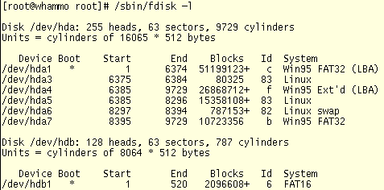
Write this information down! or Save copy to USB

Slide 26
A device name refers to the entire disk.
/dev/hda is IDE hard drive A
/dev/hdb is IDE hard drive B
/dev/sda is SCSI hard drive A
/dev/hda1 is the first partition on IDE hard drive A
/dev/sdb5 is the fifth partition on SCSI hard drive B
/dev/fd0 is the floppy
/dev/cdrom is the cdrom
/dev/cdrom1 is the second cdrom

